Slide 1
Chongqing University of Technology
ATAI
Advanced Technique of Artificial Intelligence
Chongqing University of Technology
COHESION: Composite Graph Convolutional Network with Dual-Stage Fusion for Multimodal Recommendation
Code：None
2025.5.12 • ChongQing
—— SIGIR 2025
Reported by Peng Shan

Slide 2
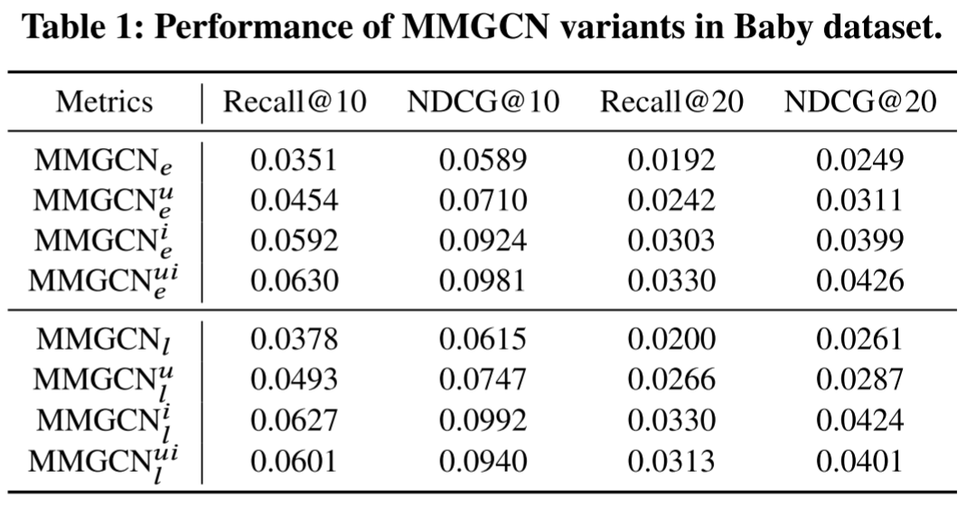
Motivation
(1) Previous approaches in modality fusion often employ simplistic attentive or pre-defined strategies at early or late stages, failing to effectively handle irrelevant information among modalities.
(2) Modality fusion and representation learning were considered as two independent processes in previous work. In this paper, we reveal that these two processes are complementary and can support each other.

Slide 3
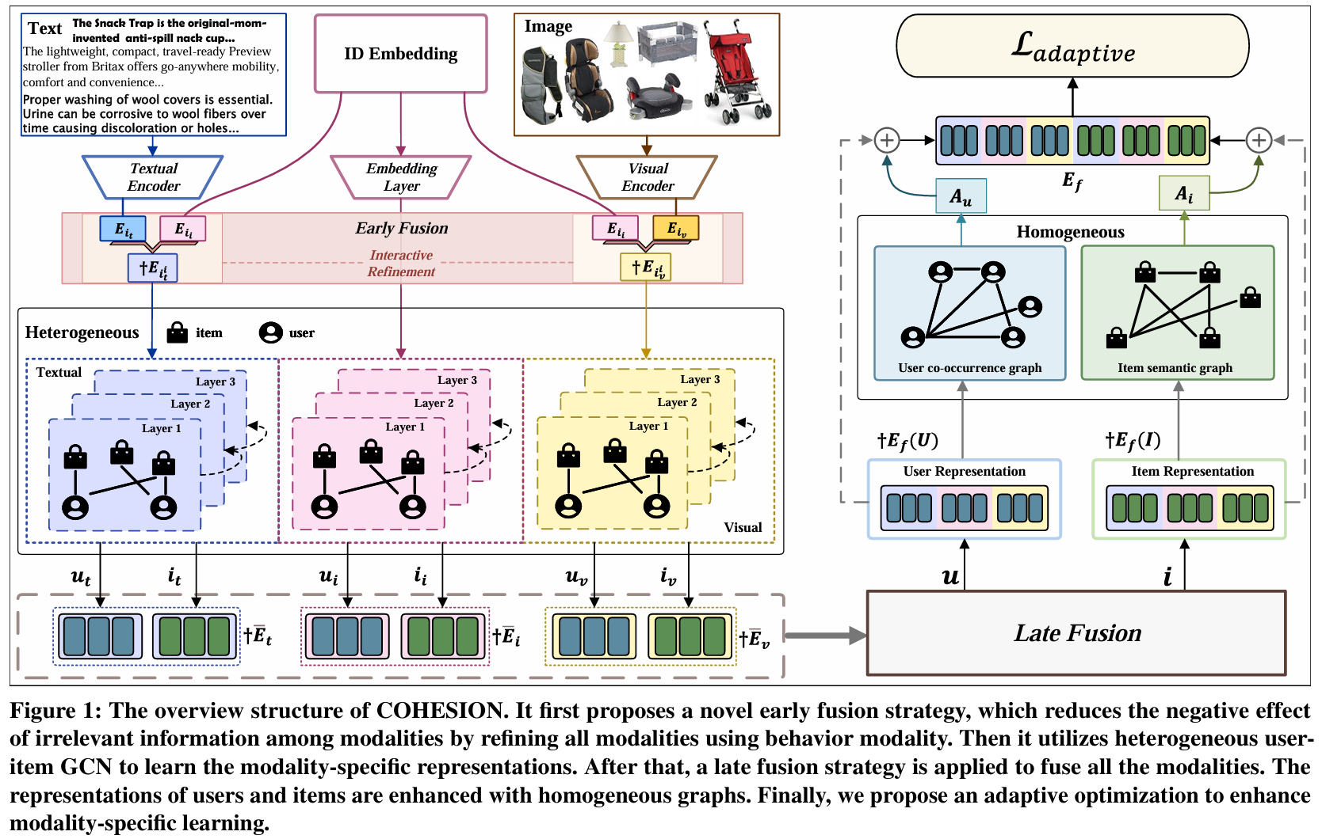
Method

Slide 4
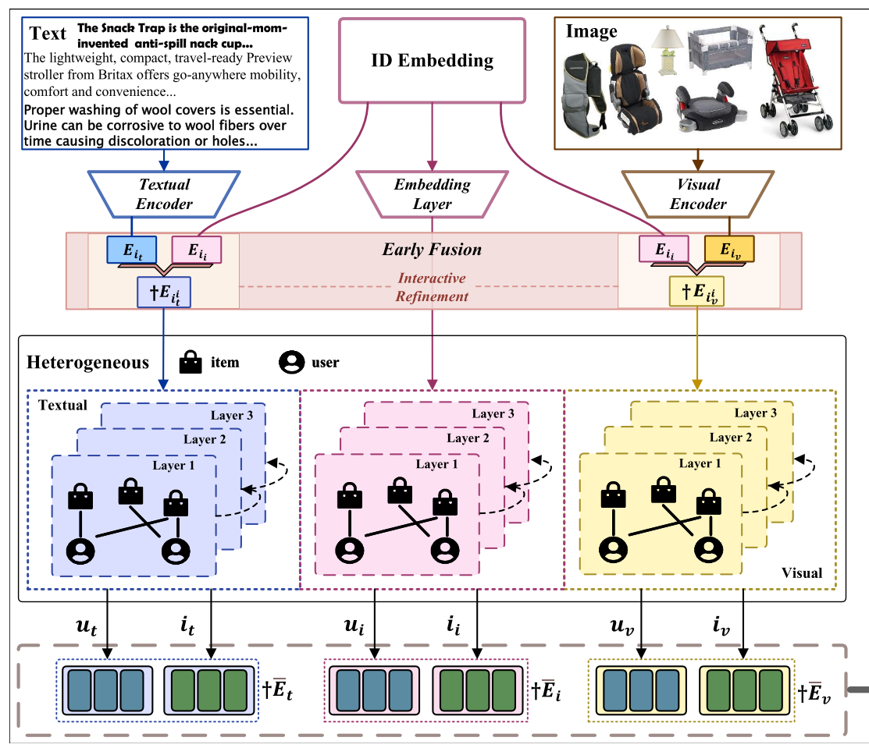
Method

Slide 5
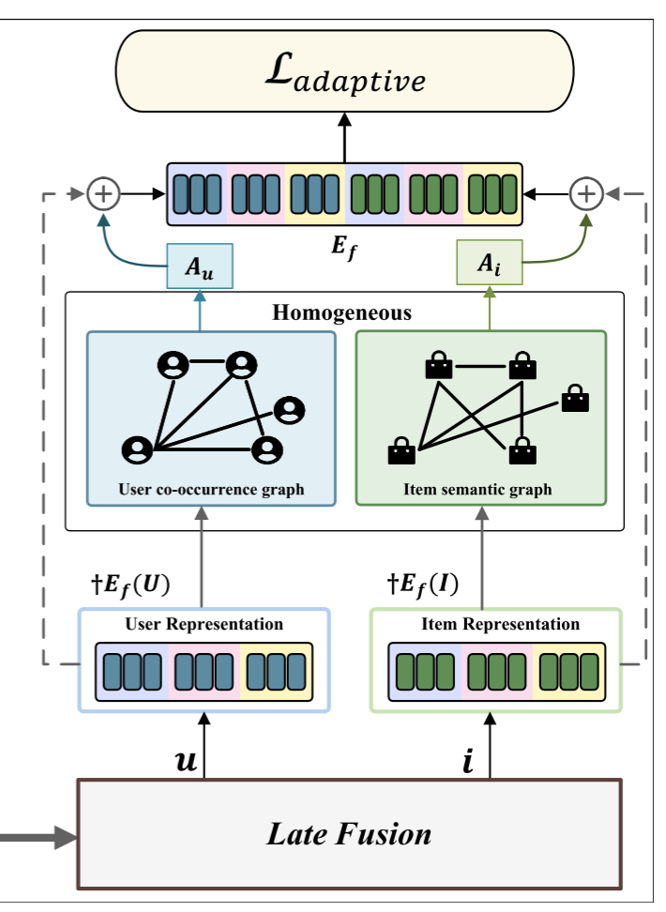
Method

Slide 6
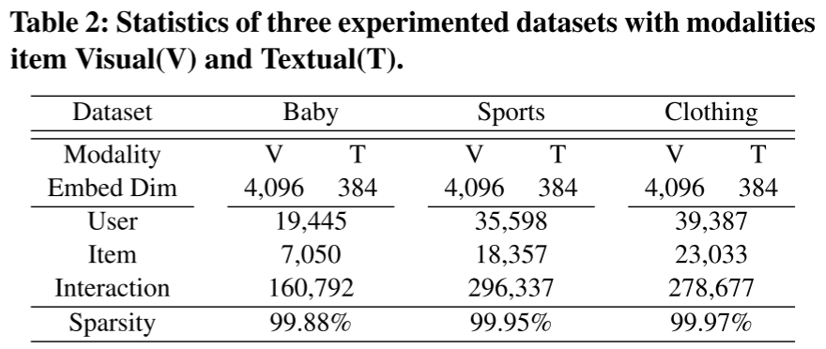
Experiments

Slide 7
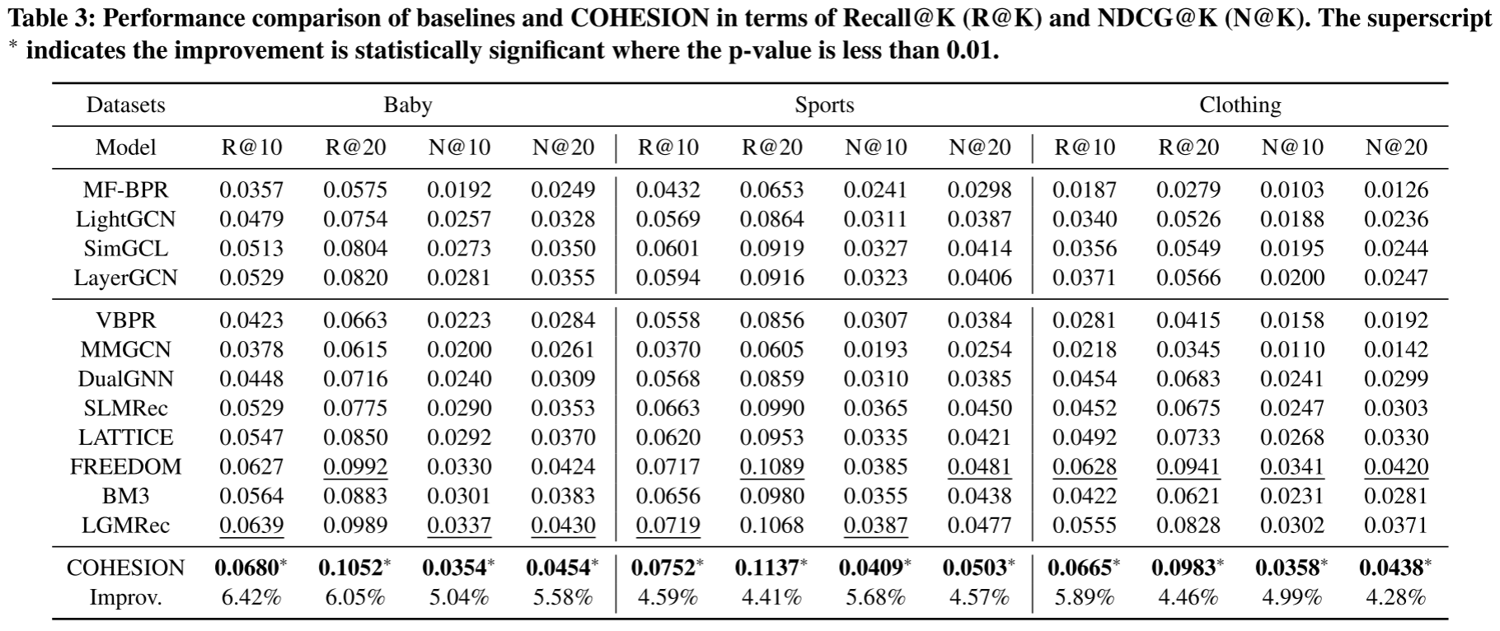
Experiments

Slide 8
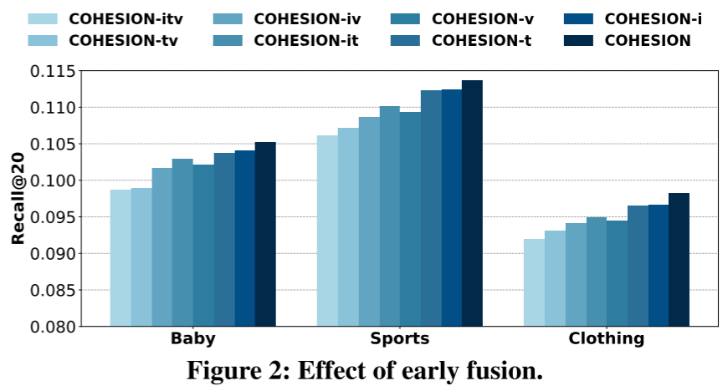
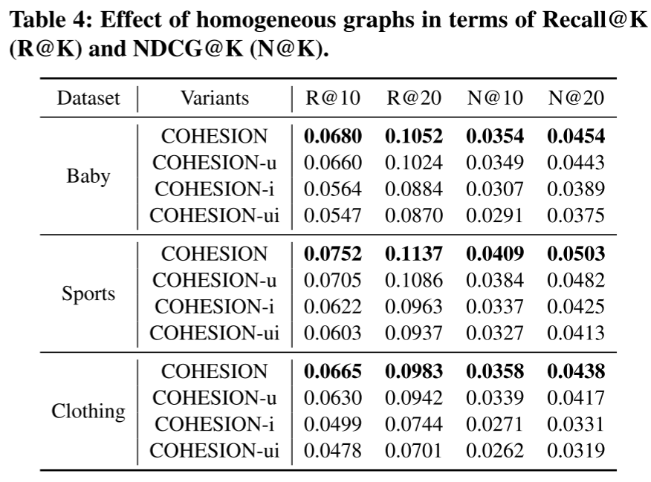
Experiments

Slide 9
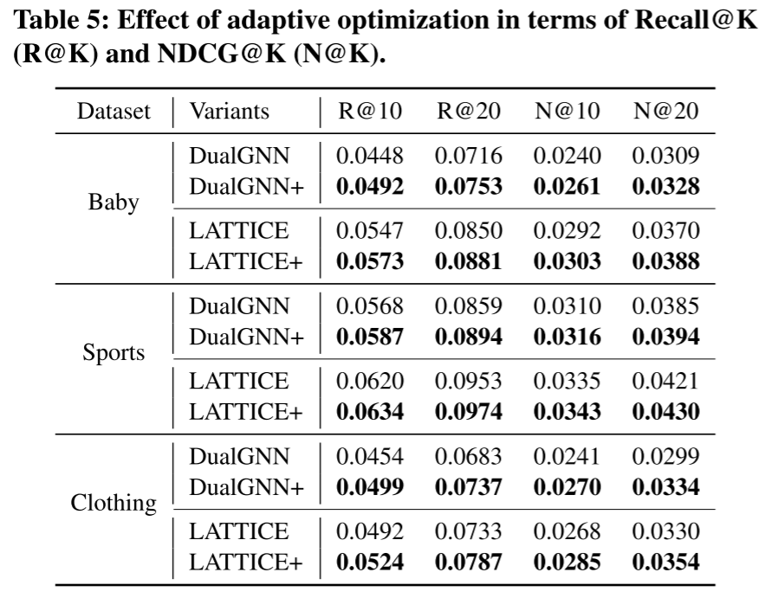
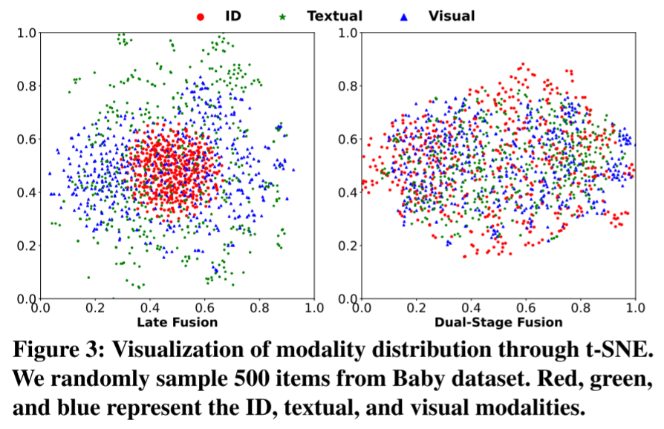
Experiments

Slide 10
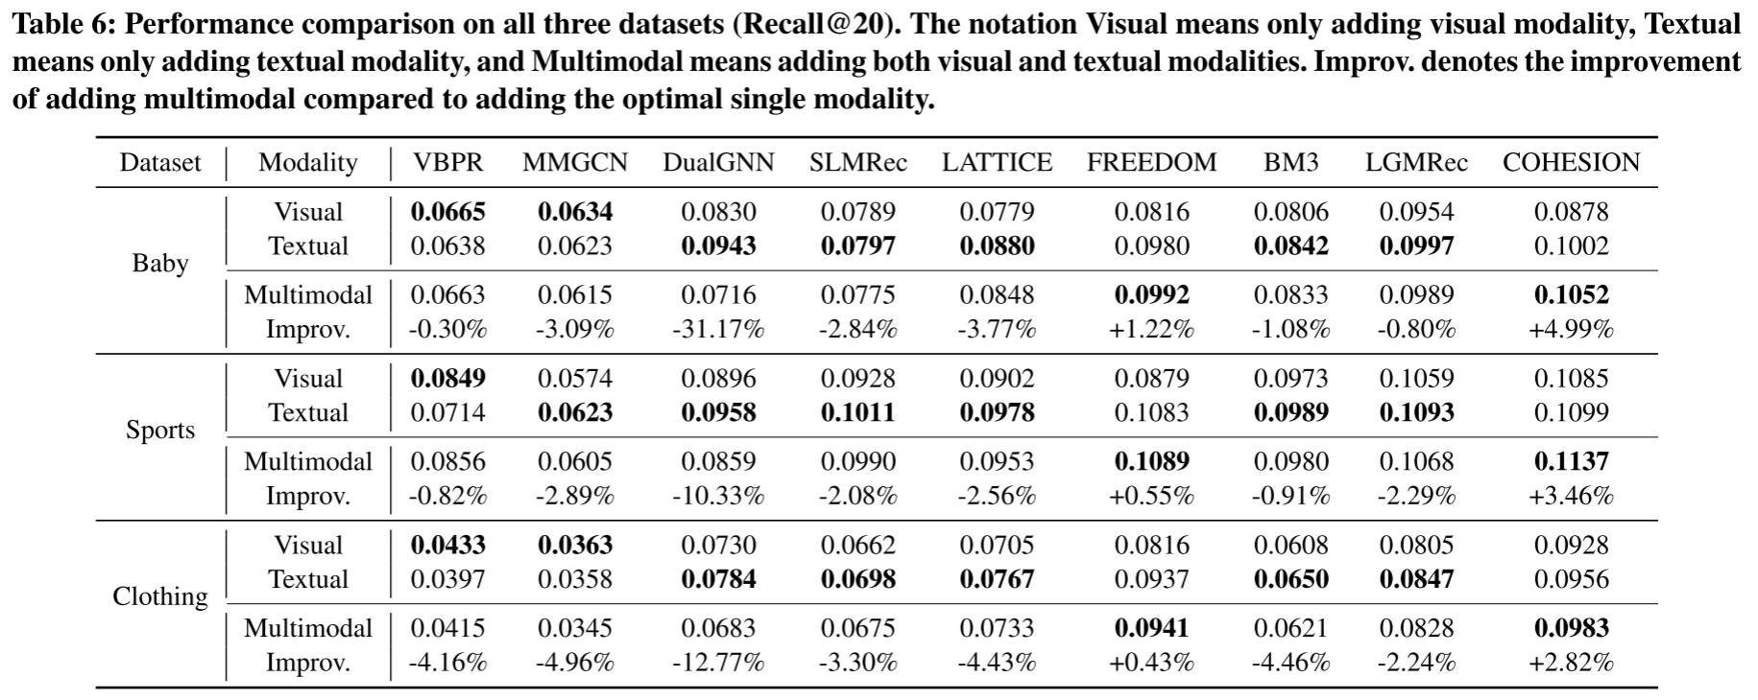
Experiments

Slide 11
Experiments

Slide 12
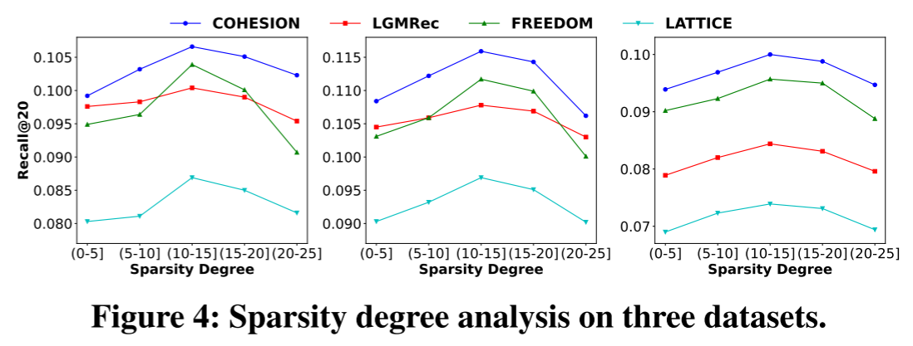
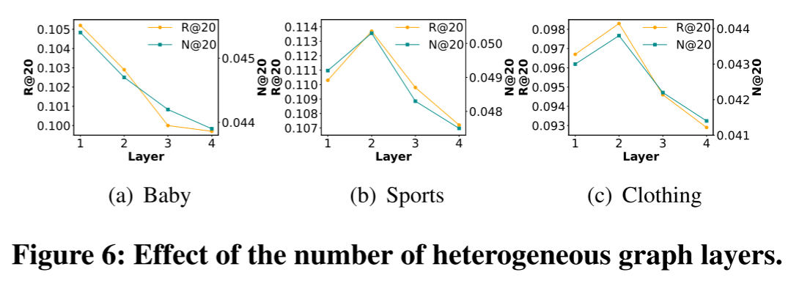
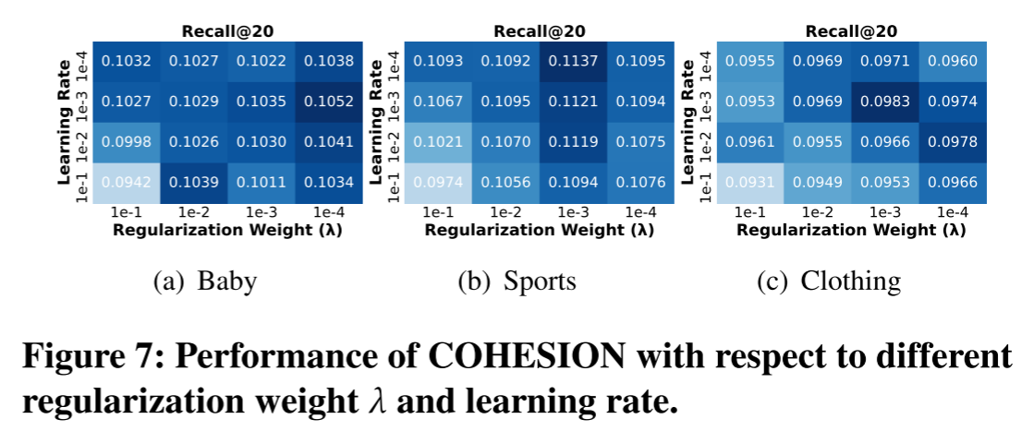
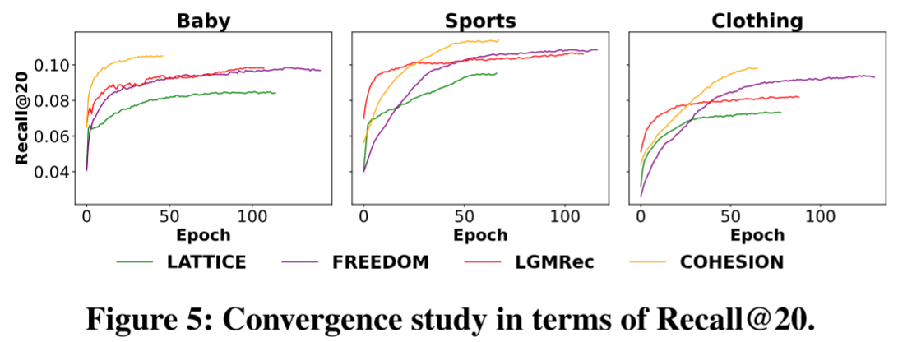
Experiments

Slide 13
Thanks!

